Slide 1
Dungeons Dragons
American University of Armenia
CS120 Introduction to Object-Oriented Programming Spring 2022
Group 26: Levon Keshishoghlyan, Mariam Makaryan, Suren Manukyan
&
&

Slide 2
Contents of this template
Project Choice
Expectations
Process
Current Result
Further improvements

Slide 3
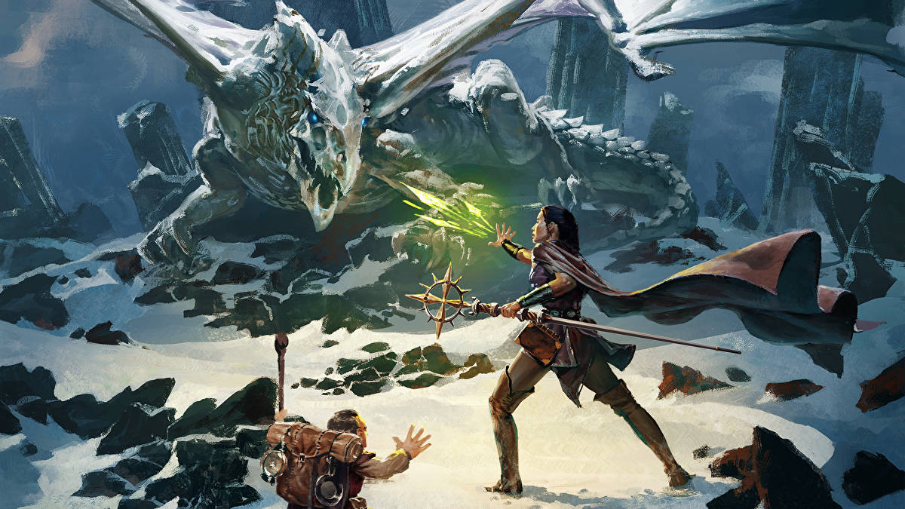
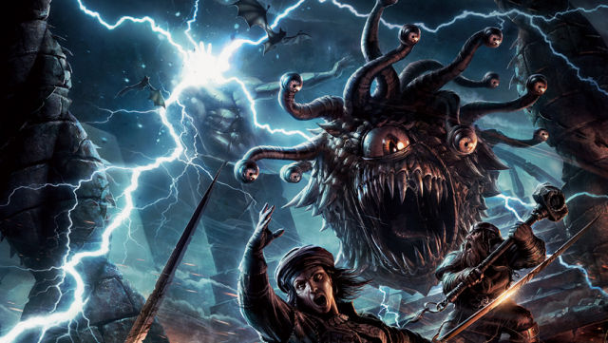
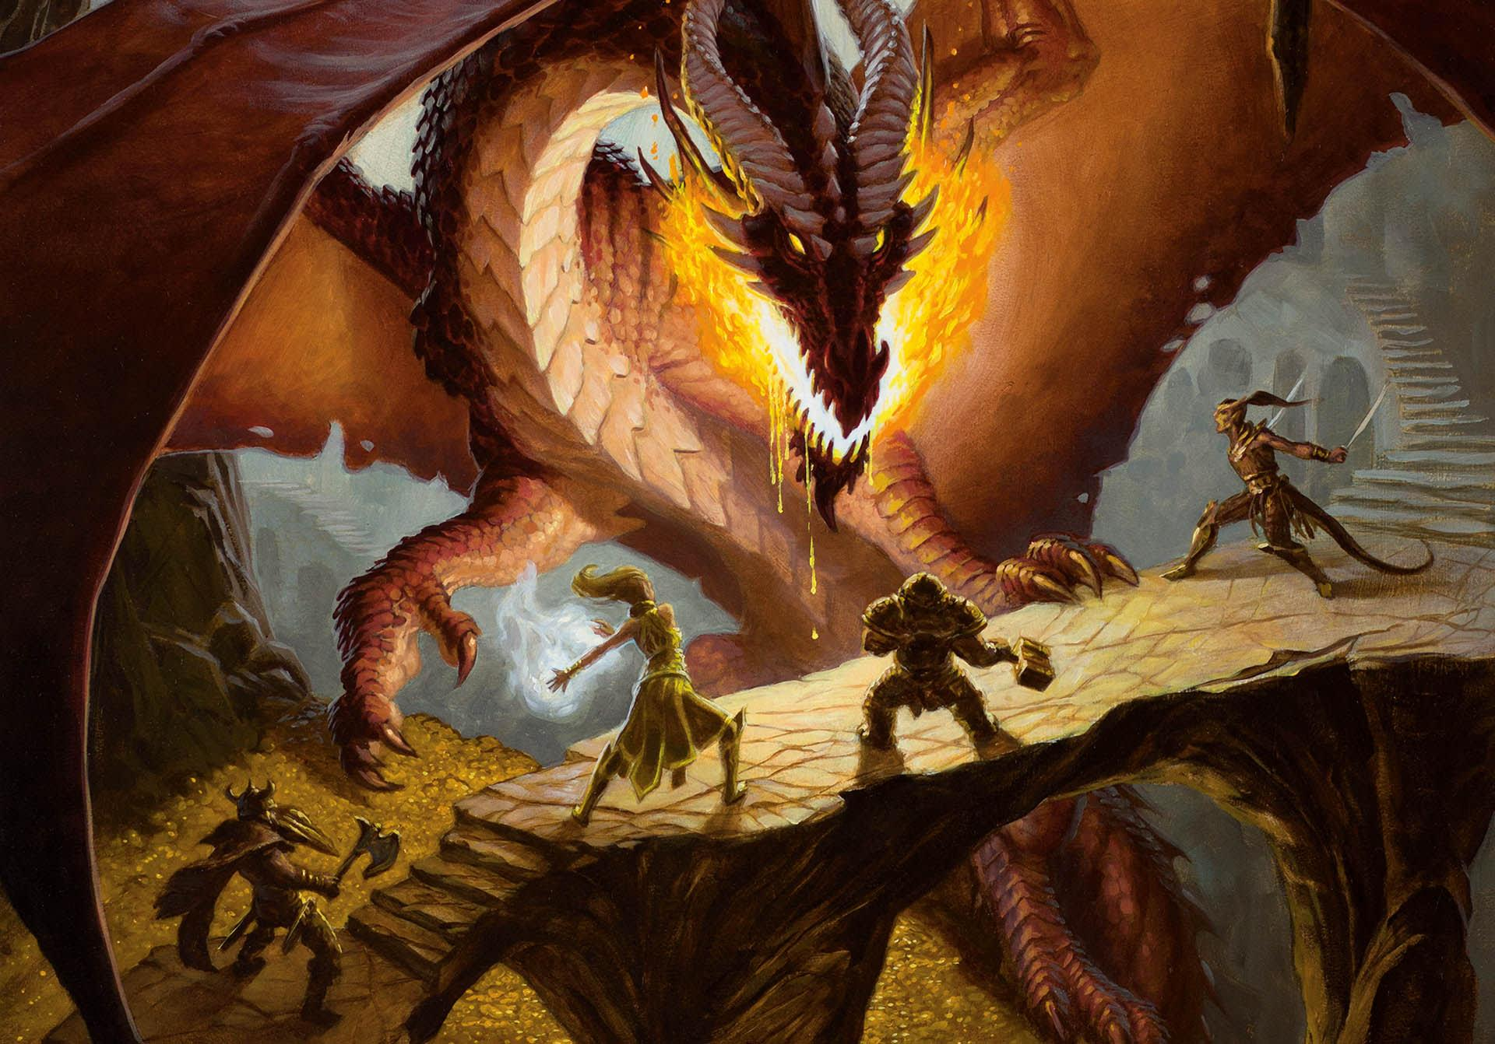
Project Choice

Slide 4
Expectations
Well designed GUI
Multiple story lines
Lot of weapons and spells
Variety of choices

Slide 5
But

Slide 6
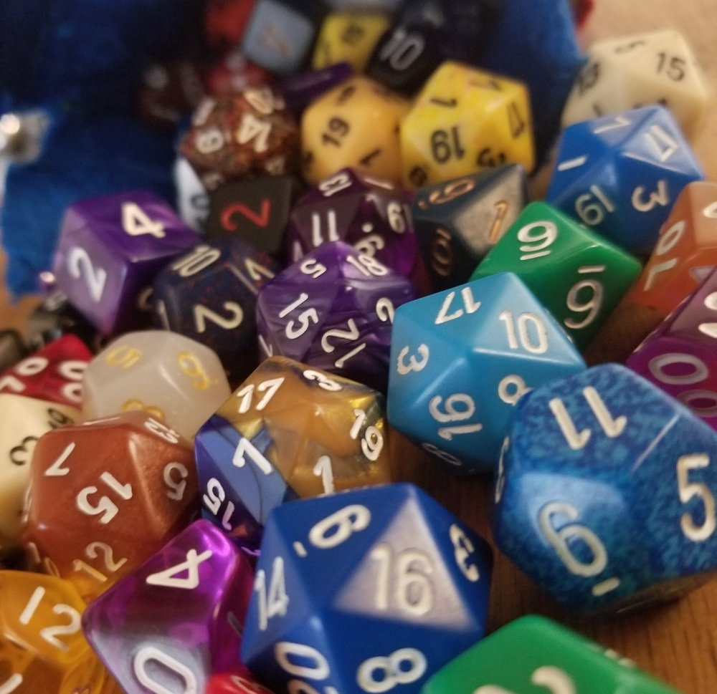
we

Slide 7
we
java.swing
java.swing
java.swing
java.swing
java.swing
java.swing

Slide 8
Process
packages
Battle
Engine
Entity
ItemsAndSpells
Parsers

Slide 9
Current Results

Slide 10
Further improvements
01
02
Caracter choice
More story branching
03
04
Add more Items and Weapons
GUI development

Slide 11
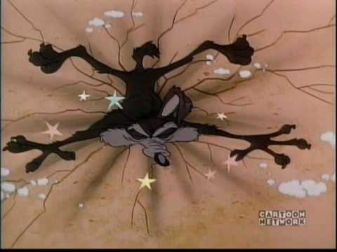

Slide 12
Thank you
No questions?
Bye

